Slide 1
DengAI
Predicting Disease Spread
140595M - H.G.P.D. Somathilaka
140295T - L.H.D.D. Karunathilake
140489R - S.I. Rajapakse
140032L - K.G.L.K. Ananda
Group : MLG2

Slide 2
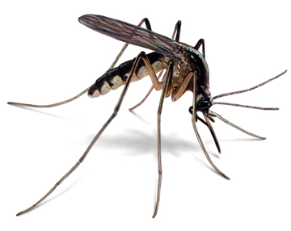
Introduction
Dengue fever is transmitted by the bite of an Aedes mosquito infected with the dengue virus.
Transmitted through mosquitoes and infected people
There is a strong correlation of disease propagation with climate changes.
Various sensors which are sensitive to different parameters in the surrounding are used to gather data continuously and based upon that, weather conditions can be predicted.
Consider a time period with higher temperature and lesser humidity, there is a higher chance of that time period belong to a summer period rather than a winter.

Slide 3

Problem Statement
Our task was to predict the number of dengue cases each week (in each location) based on environmental variables describing changes in temperature, precipitation, vegetation, using environmental data collected by various U.S. Federal Government agencies from the Centers for Disease Control and Prevention to the National Oceanic and Atmospheric Administration in the U.S. Department of Commerce.

Slide 4





Data Analysis
Tools and Libraries
NumPy
SciPy
Pandas
MatPlotLib
Scikit-learn

Slide 5

Methodology
Distribution analysis
Correlation analysis
Feature selection
Missing values
Machine learning models
Prediction
Results and analysis

Slide 6

Dataset
Two cities => San Juan and Iquitos
4 datasets in csv format
1456 records in training dataset and label dataset
24 distinct training features
417 records in test dataset

Slide 7
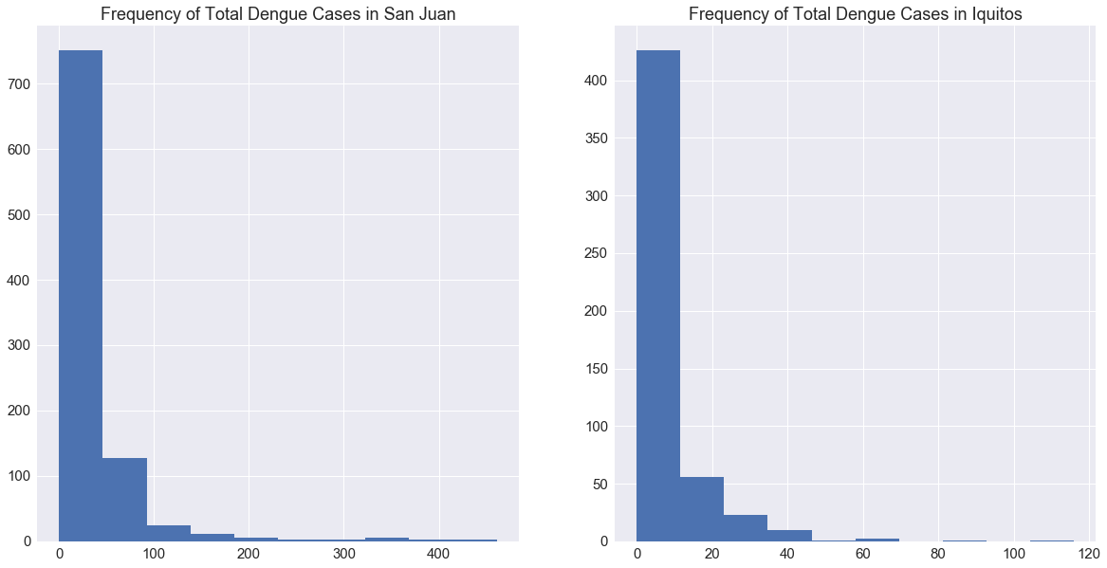
Distribution analysis

Slide 8
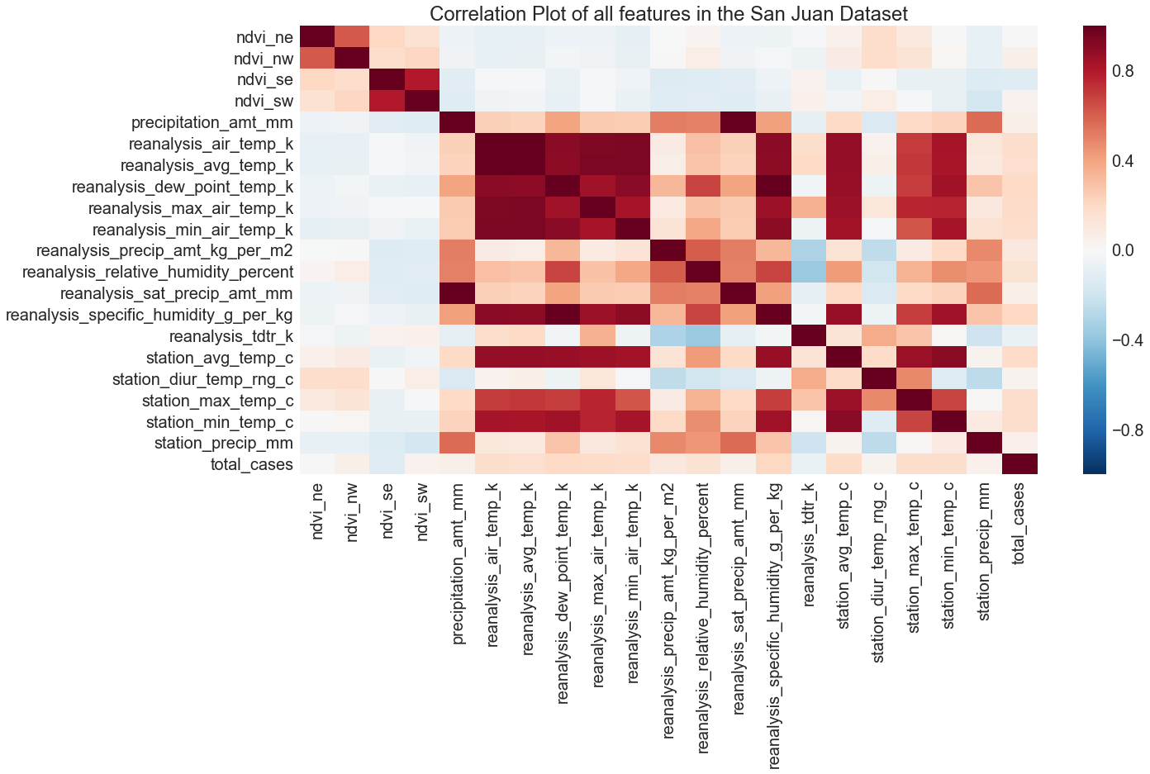
Correlation analysis
Notes:
How each attribute contributes to the total cases value.

Slide 9
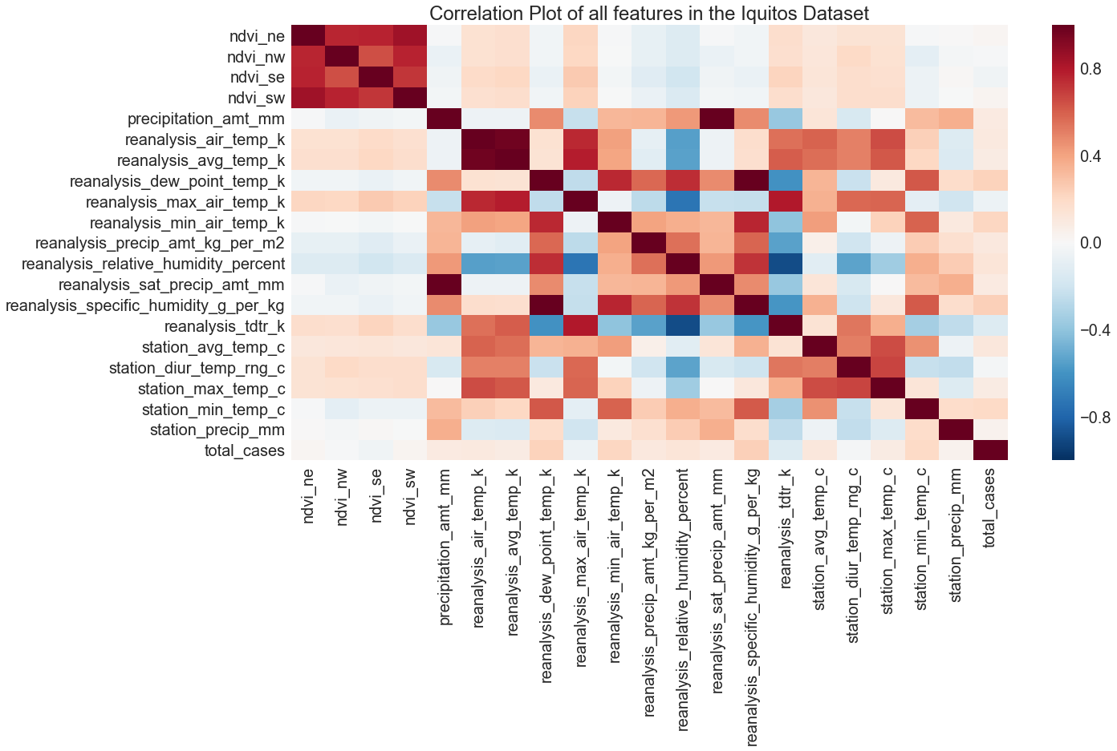
Correlation analysis

Slide 10

Feature Selection
ndvi_se
ndvi_sw
ndvi_ne
ndvi_nw
avg_air_temp
dew_point
humidity_percentage
total_precipitation

Slide 11

Missing values
Calculate the mean of each feature
Consecutive missing values - fill each missing value with mean
Else - Average of previous and next values

Slide 12

Machine Learning Models
Poisson model
Ridge Regression model
Lasso Regression model
Time Series Regression Model
Linear Regression model
Non-linear Regression model
Negative Binomial Regression model

Slide 13


Scoring Method
Mean Absolute Error
Lower score is better

Slide 14
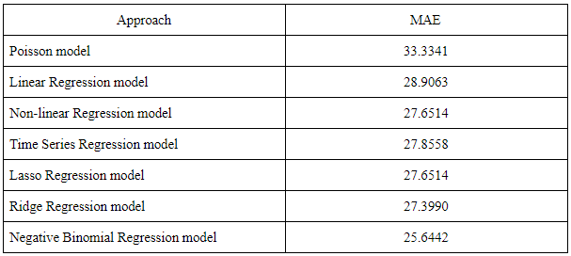
Results and Analysis

Slide 15

Conclusion
Data analysis step is crucial
Temperature and humidity has a huge effect on prediction
Total cases distribution is not a Poisson distribution
Negative binomial regression model predicts more accurately

Slide 16
Thank you

